Slide 1
Young's Modulus Measurement Based on Accelerometer
VM395 Laboratory I
Tue Group 1
Hanzhi Wang, Junjie Luo, Yixuan Wang
August 5, 2019

Slide 2
Outline
Introduction
Experiment
Discussion

Slide 3
Introduction
Yixuan Wang

Slide 4
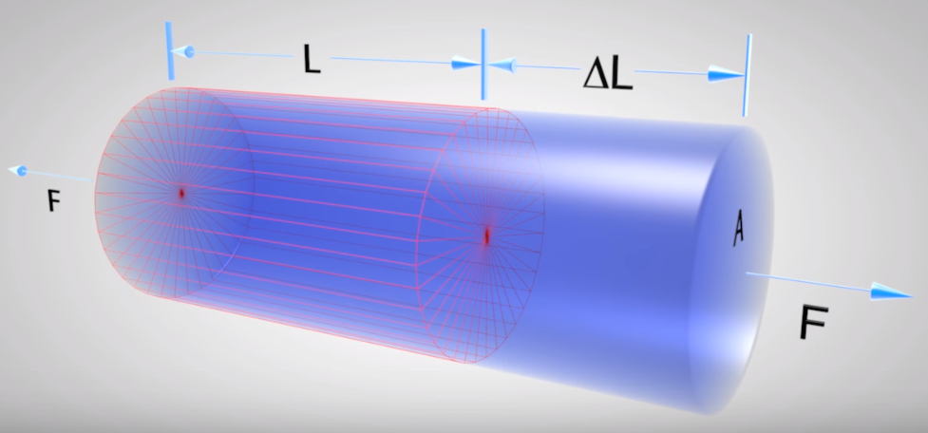
Background Information
$$E=\frac{FL}{AΔL}$$
Analysis
Stiffness
Design
Figure Resource: https://www.youtube.com/watch?reload=9&v=2SRMq0pzTgI

Slide 5
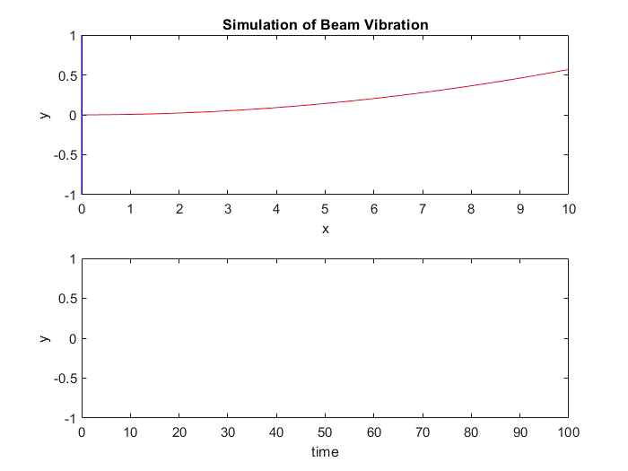
Beam Vibration
$$y=Ae^{−Kt}\sin{(ωt+φ)}$$

Slide 6
Old Method
Displacement
Resistance
Voltage
Strain Gauge
Wheatstone Bridge Circuit
Linear Transformation

Slide 7
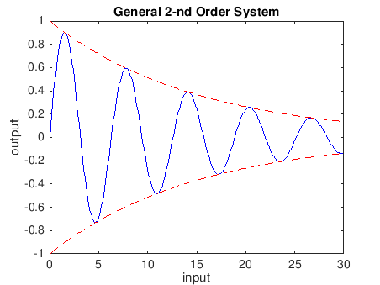
Old Method
Expected voltage output
$$V=Ae^{−Kt}\sin{(ωt+φ)}$$
$$V=Ae^{−Kt}$$
Curve Fitting!

Slide 8
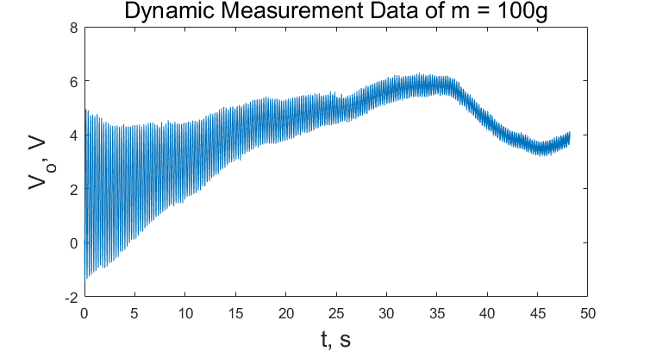
Old Method
?

Slide 9
New Method
Displacement
Acceleration
Accelerometer
Accurate but …

Slide 10
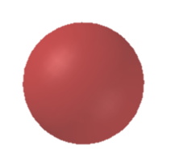
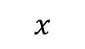




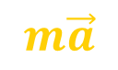



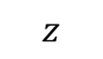
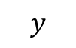

New Method
$$\vec{F}$$
$$z$$
$$m\vec{a}$$
$$y$$
$$m\vec{g}$$
$$x$$
$$F_{x}$$
$$V_{x}$$
$$F_{y}$$
$$V_{y}$$
$$F_{z}$$
$$V_{z}$$

Slide 11
New Method
$$z$$
$$\vec{a}$$
$$y$$
Accelerometer
$$x$$
$$\vec{g}$$
Output
$${\left(\vec{g}+\vec{a}\right)}_{x}$$
(𝑔 ⃗+𝑎 ⃗ )_𝑥
$${\left(\vec{g}+\vec{a}\right)}_{y}$$
(𝑔 ⃗+𝑎 ⃗ )_𝑦
$${\left(\vec{g}+\vec{a}\right)}_{z}$$
(𝑔 ⃗+𝑎 ⃗ )_𝑧
Gesture
Acceleration

Slide 12
New Method
Solution:
Magic: approximation
$a=Ae^{−Kt}\sin{(ωt+φ)}$
Amazing Result!

Slide 13
Problem
Problem
Can method based on accelerometer work?
How well does method based on accelerometer work, compared with old method?

Slide 14
Experiment
Junjie Luo

Slide 15
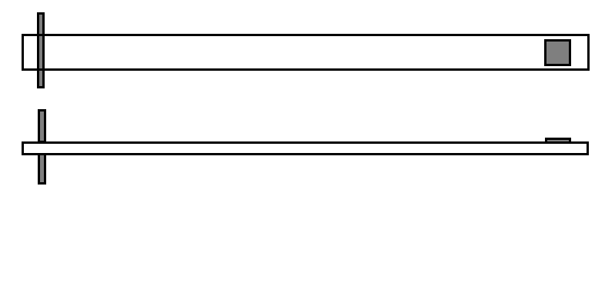
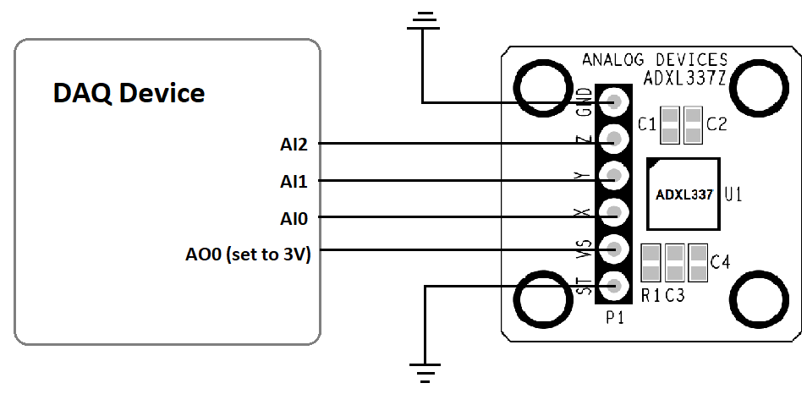
Equipment
Equipment
Clamp
Aluminum beam
ADXL337 Accelerometer
Top View
Width b
Side View
Thickness t
Length t
Vibration (Acceleration)
Notes:
I will firstly introduce the equipment briefly. This is our equipment and the circuit. We attached an accelerometer to the beam, and the accelerometer is also connected into a DAQ device, which supply its required working voltage and record the output voltages of the accelerometer. We will vibrate the end of the beam and record the output voltage of the circuit.

Slide 16
Procedure
Set up equipment
Attach accelerometer
Set up circuit
4
1
Analyze data
Fitting
Calculation
3
2
Record acceleration
Vibrate the beam
LabView
Several times
large and small

Slide 17
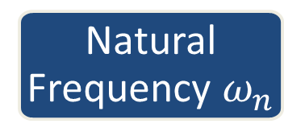
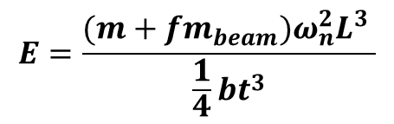
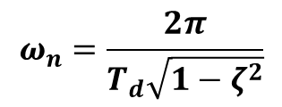
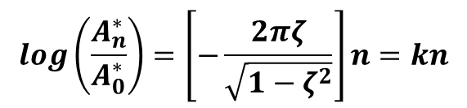
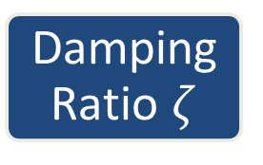
Result
$$\log\left(\frac{A_{n}^{∗}}{A_{0}^{∗}}\right)=\left[−\frac{2πζ}{\sqrt{1−ζ^{2}}}\right]n=kn$$
$$ω_{n}=\frac{2π}{T_{d}\sqrt{1−ζ^{2}}}$$
$$E=\frac{(m+fm_{beam})ω_{n}^{2}L^{3} }{\frac{1}{4}bt^{3}}$$
Curve Fitting
Damping Ratio $ζ$
Natural Frequency $ω_{n}$
Time Period T_{d}
Young’s Modulus
Beam Parameters
Average E = 56.22Gpa

Slide 18
Discussion
Hanzhi Wang

Slide 19
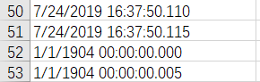
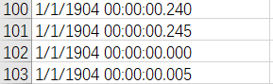
LabVIEW Recording Error
Time recording error of LabVIEW
Time data is incorrect
Problematic with MATLAB
Find average time interval = 0.005s and assign time points manually
$$T^{n^{th}}=0.005×n$$

Slide 20
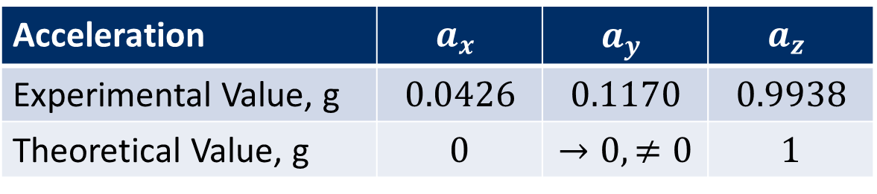
Static Gesture of Accelerometer
Gesture of accelerometer not aligned horizontally
At steady state:
Acceleration | $$a_{x}$$ | $$a_{y}$$ | $$a_{z}$$
Experimental Value, g | $$0.0426$$ | $$0.1170$$ | $$0.9938$$
Theoretical Value, g | $$0$$ | $$→0, ≠0$$ | $$1$$

Slide 21
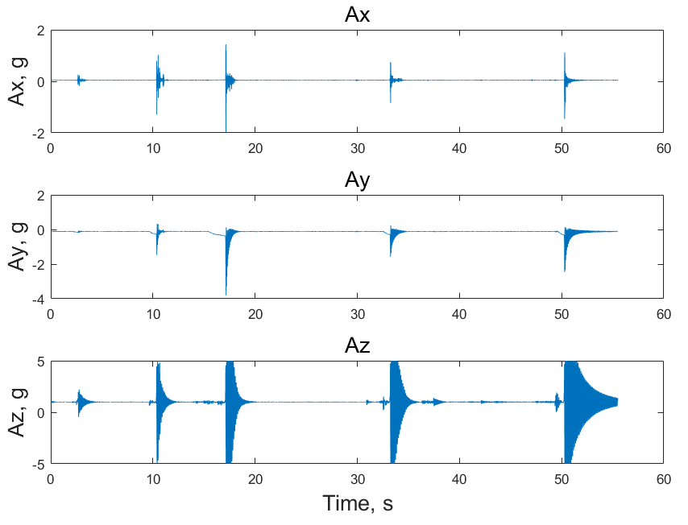
Static Gesture of Accelerometer
Acceleration is distributed into 3 axes
Does not affect E calculation.
Oscillation amplitude is smaller than actual value.

Slide 22
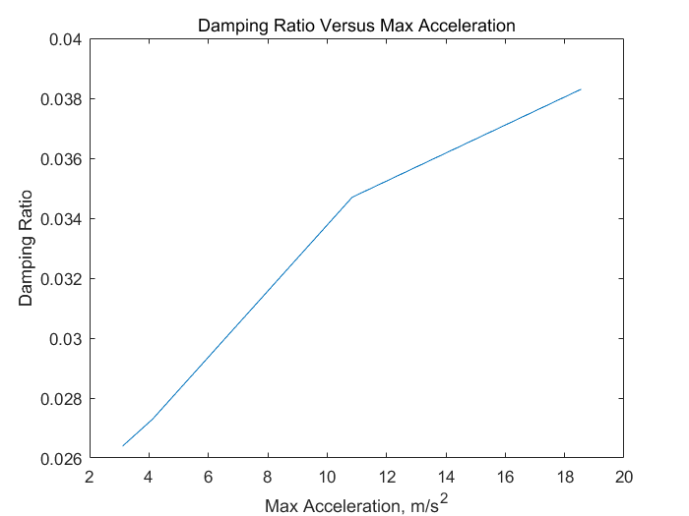
Non-linear Damping
Damping ratio is not constant, although load is the same
$ζ$ increases as oscillation amplitude increases.
 | Set 1 | Set 2 | Set 3 | Set 4
Max Acceleration, $\frac{m}{s^{2}}$ | $$3.12$$ | $$4.1248$$ | $$10.845$$ | $$18.55$$
Damping ratio | $$0.0264$$ | $$0.0273$$ | $$0.0347$$ | $$0.0383$$

Slide 23
Non-linear Damping
Larger Amplitude
Larger Damping Ratio
Inconsistent with Linear ODE Model

Slide 24
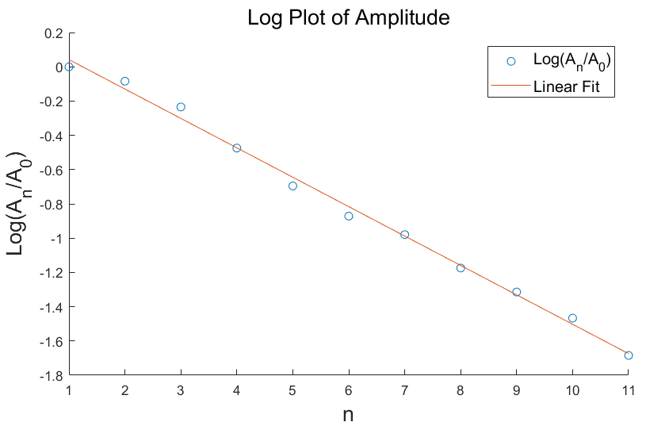
Non-linear Damping
Model accuracy is affected:
Log fit $R^{2}= 0.992$

Slide 25
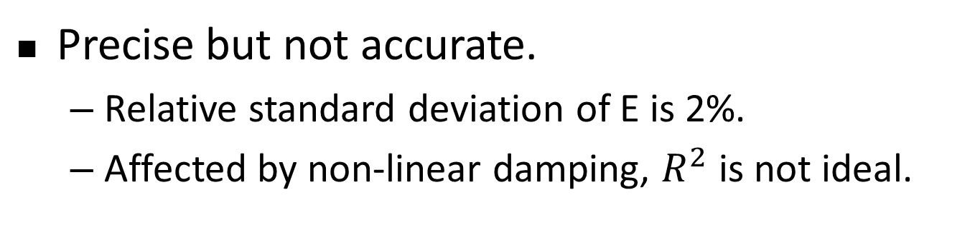
Conclusion: Evaluation
Gesture does not affect E calculation.
$$E=56.22 Gpa$$
Precise but not accurate.
Relative standard deviation of E is 2%.
Affected by non-linear damping, $R^{2}$ is not ideal.

Slide 26
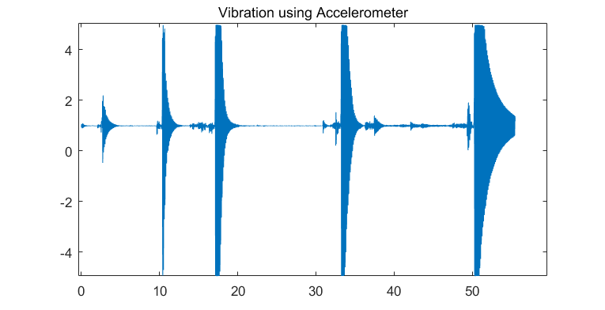
Conclusion: Comparison
Simple configuration and less noise.
Improved accuracy
$$R_{new}^{2}=0.993>R_{old}^{2}=0.980$$

Slide 27
Conclusion: Future Improvement
Add a load to the end of the beam to eliminate tension effect of wires.
Load

Slide 28
Thank you Q & A
Notes:
I will talk about the experiment part.

